Slide 1

Cognizant
[ADM22DF042]-[Retail Product Management]
POD-01
MANISH SHINGARE, HIMANSHU RANJAN SINGH, PRIYANKA JATAV,
ASHI AGRAWAL, DHRITI SINHA, PRAJWAL NIRMAL
03-07-2022
©2022 Cognizant

Slide 2

1. Sign-in page
Cognizant

Slide 3

2. Log-in page
Cognizant

Slide 4

3. Home page
Cognizant

Slide 5
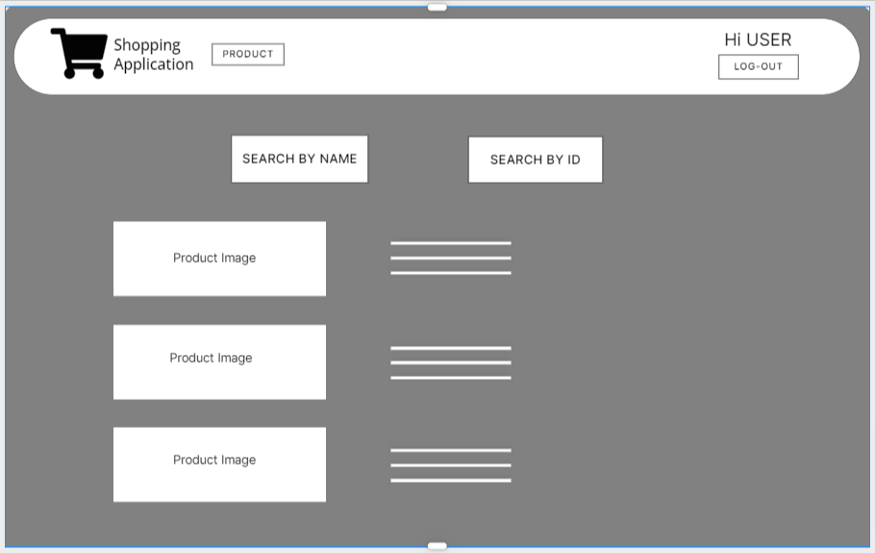
4. Search page
Cognizant

Slide 6
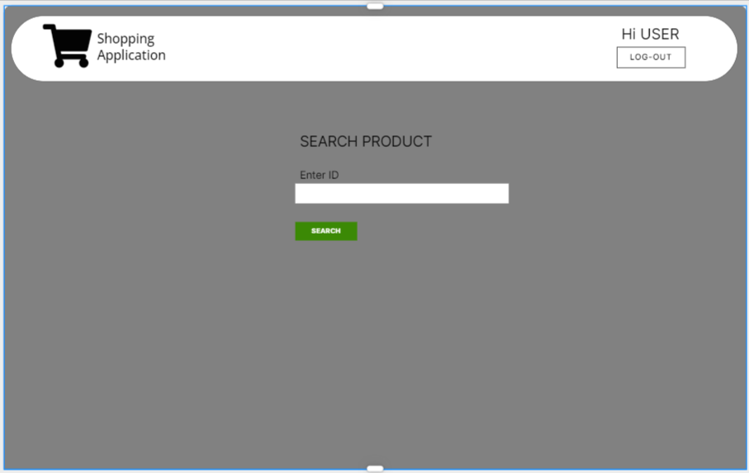
5. Search product by ID page
Cognizant

Slide 7
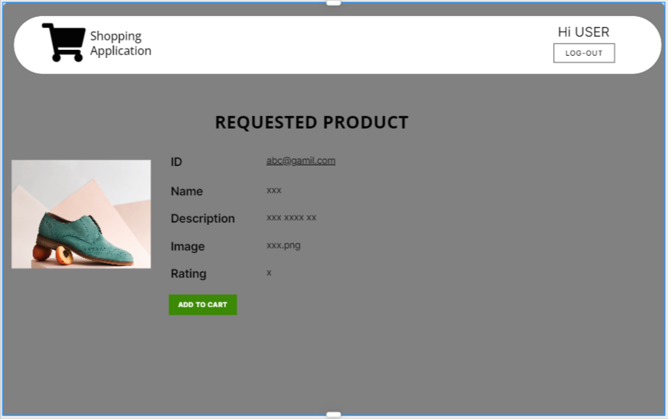
6. Product page
Cognizant

Slide 8
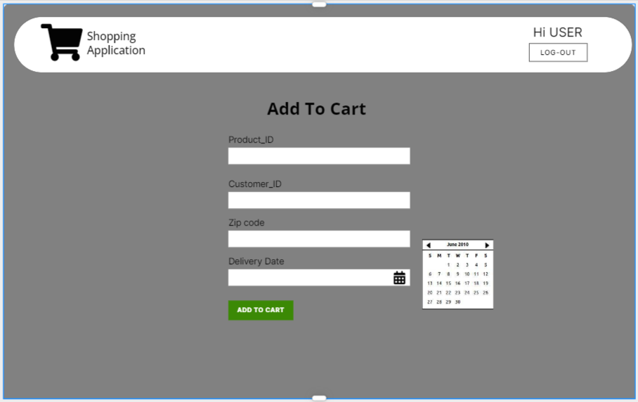
7. Add to cart page
Cognizant

Slide 9
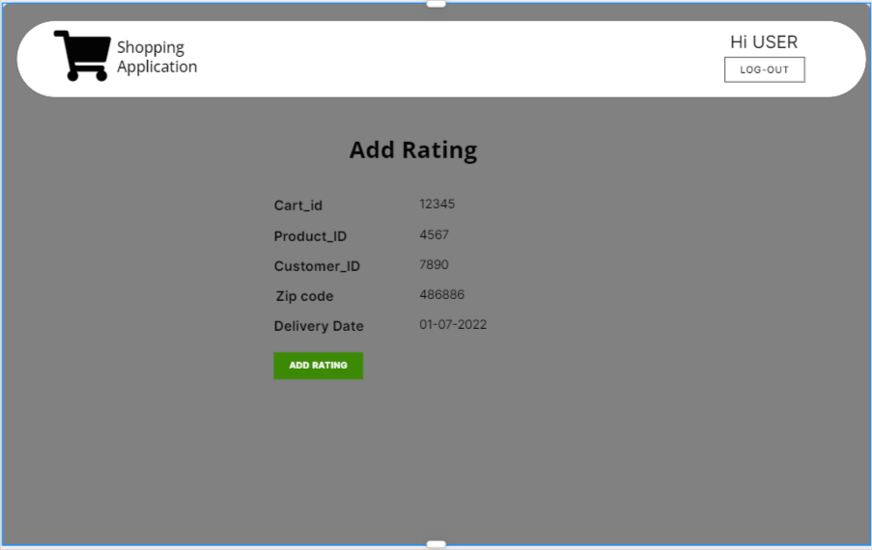
8. Add rating page
Cognizant

Slide 10
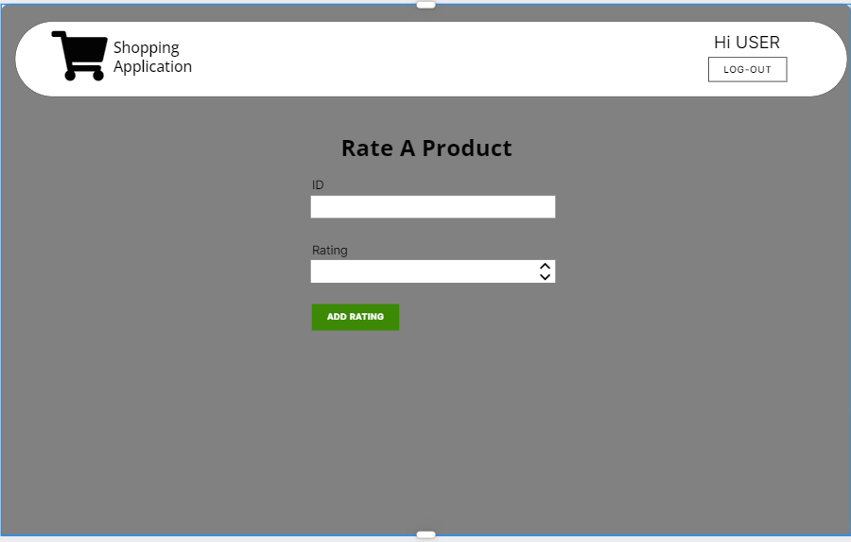
9. Rating page
Cognizant

Slide 11
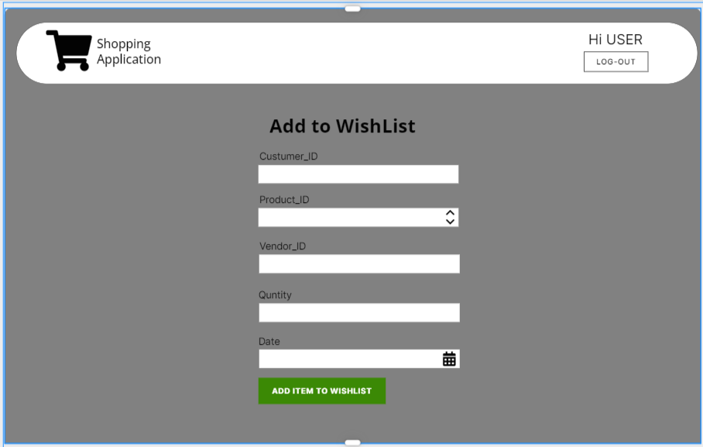
10. Add to wishlist page
Cognizant

Slide 12
Thank You!
Cognizant

